Slide 1
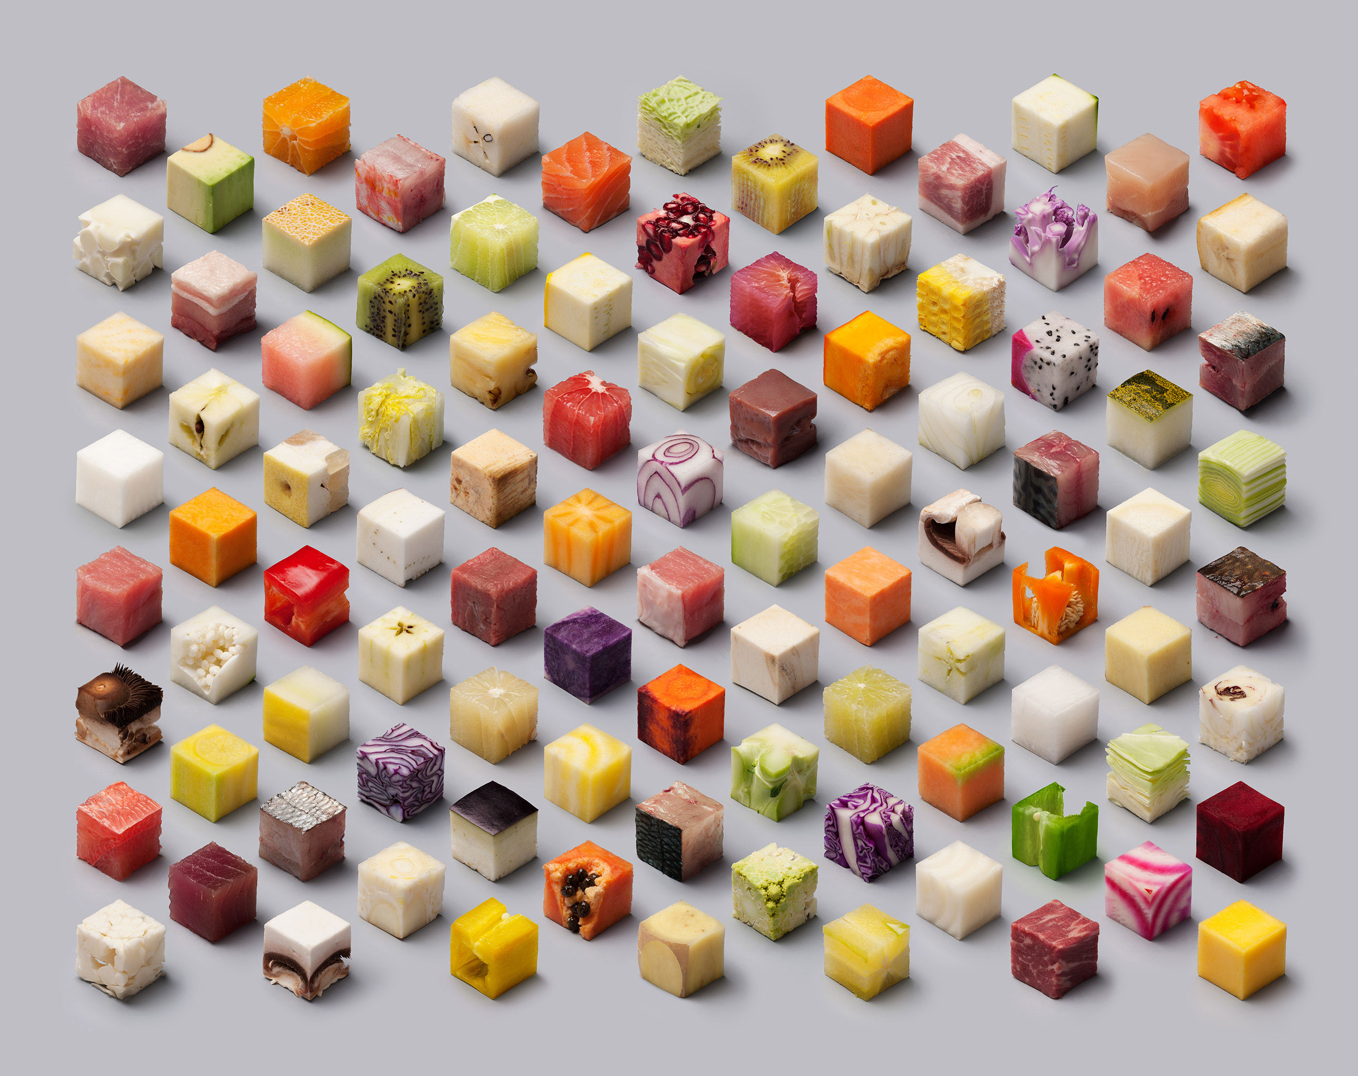
Grokking Gastronomy Nik Molnar ▪ Bit Butcher ▪ @nikmd23
Notes:
Hey everyone! I’m Nik Molnar and I’m a web developer from Austin Texas.
Typically I present about web performance and how to make the web faster, but today I wanted to do something a little different. I wanted to talk about food, and to try to use developer concepts to show everyone how to be a better cook.
15

Slide 2
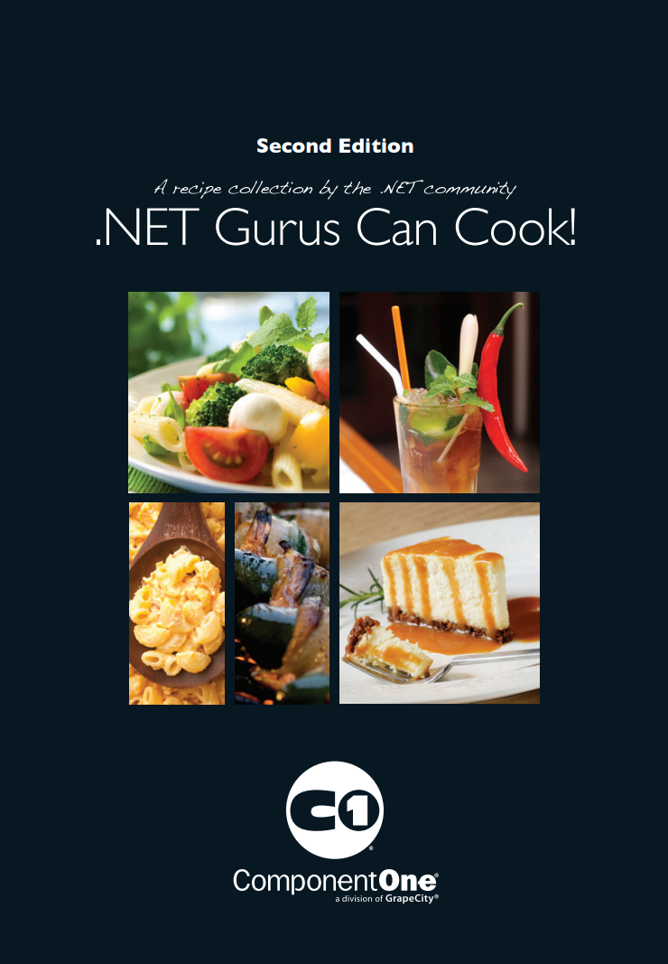
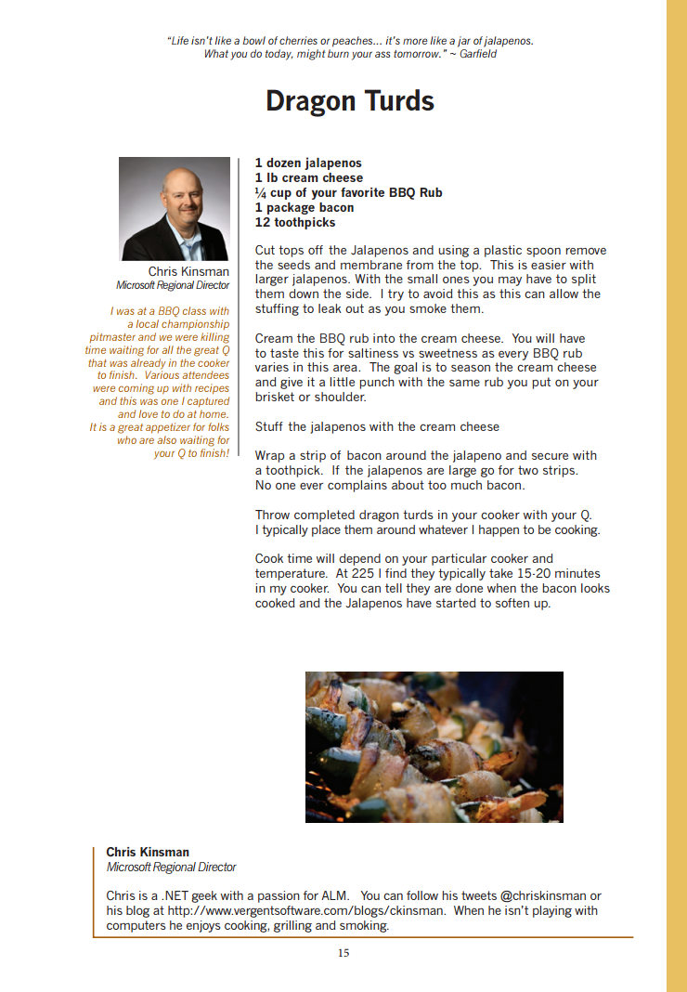
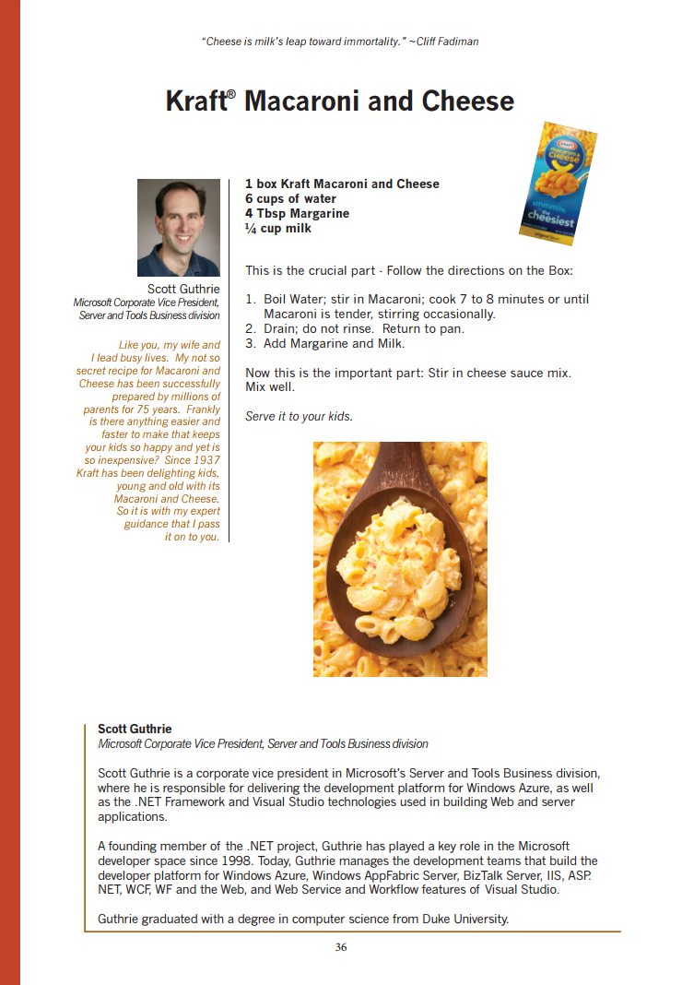
Notes:
I think I have the credentials to pull this off 1) because I’m fat and clearly know a thing or two about food, and 2) because I am published in a prestigious cookbook right along side with recipes for delicacy's like Dragon Turds and advanced French techniques like “read the back of the box”.
30

Slide 3

Why
Notes:
But lets take a moment to consider why should cook at all?
At one end of the spectrum, some people cook food simply for day to day survival, for others it’s a craft and for the best cooks out there, it’s a fine art.
45

Slide 4

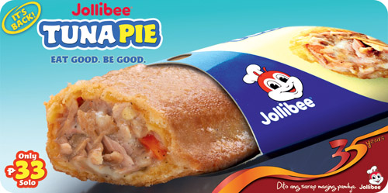
Notes:
As software developers, we work across a similar spectrum.
Sometimes you have no other options and your forced to choke down gas station food to survive. That the powershell script you wrote that one time to do to that one thing
1:00

Slide 5
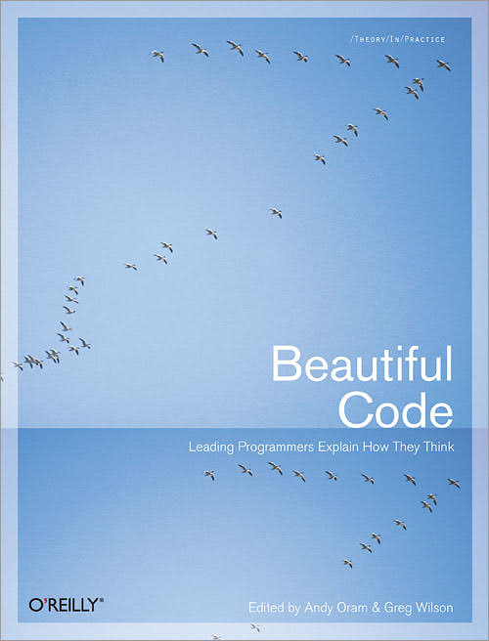
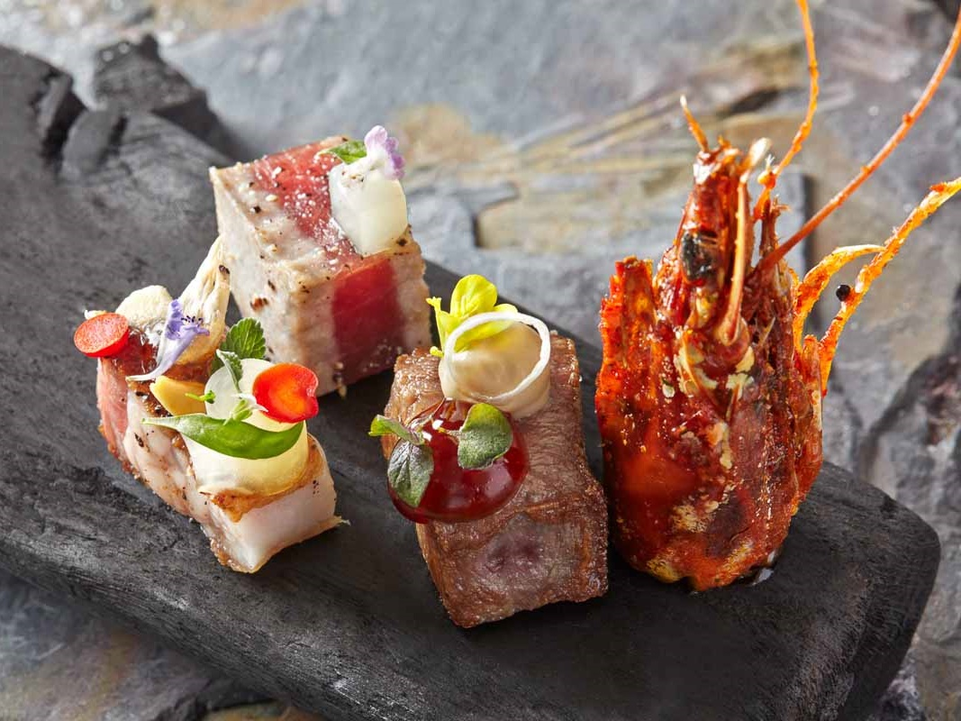
Notes:
and some of us, definitely not Niall, but some of us, write code so beautiful that it’s ogled over and moves us into a new way of thinking. Really good food does the same thing, and changes the way we think about a place or a culture.
1:15

Slide 6
How
Notes:
So how can you, my fellow software development nerds improve your own cooking craft? Let’s apply some lessons I’ve picked from our line of work. We’ll cover the intrinsics first.
1:30

Slide 7
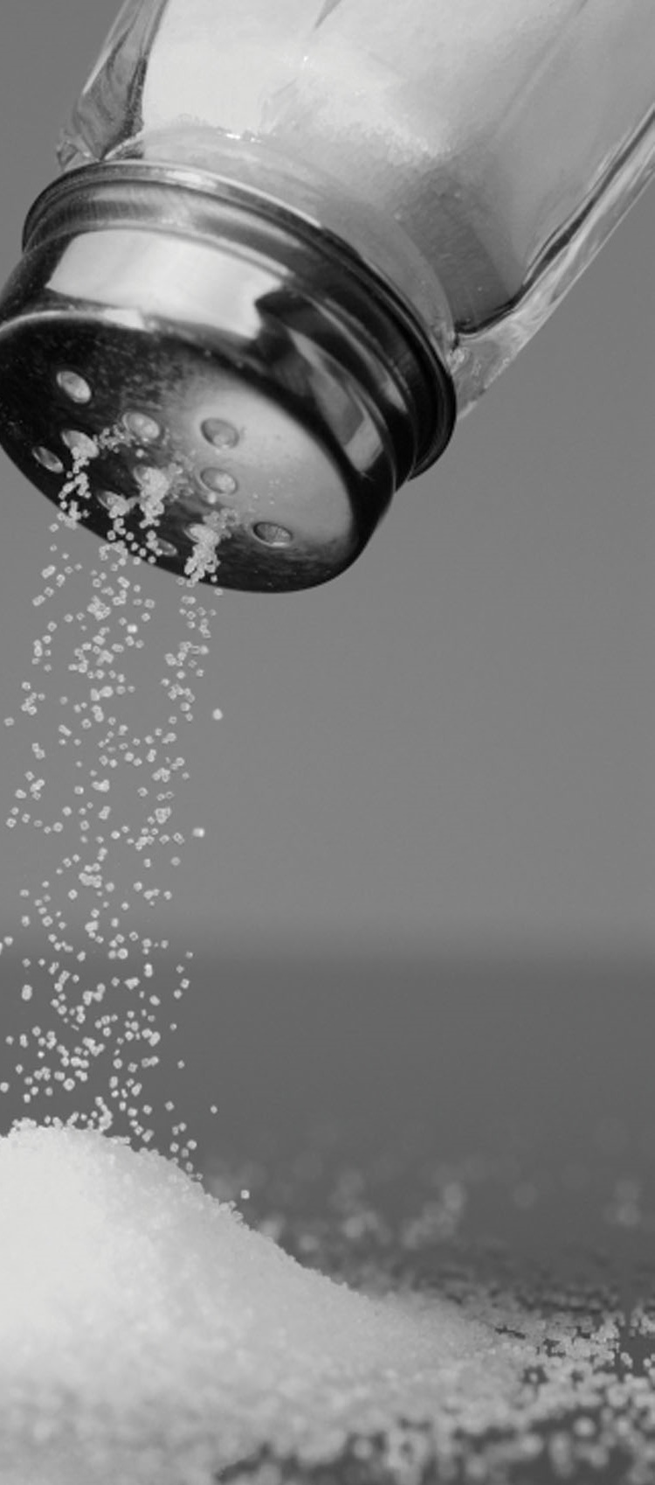
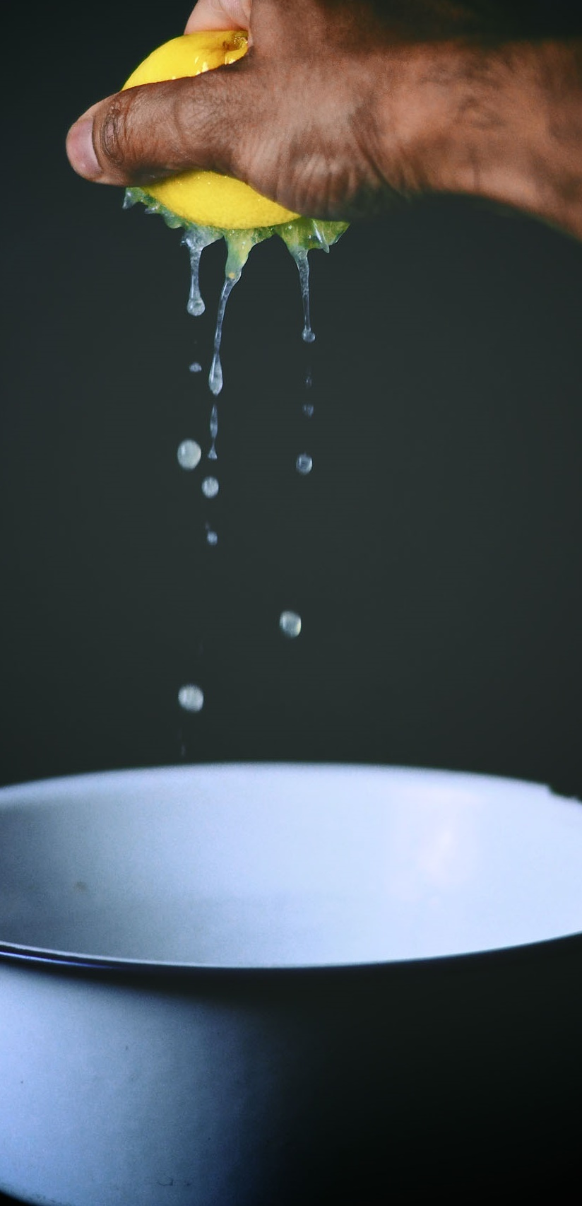
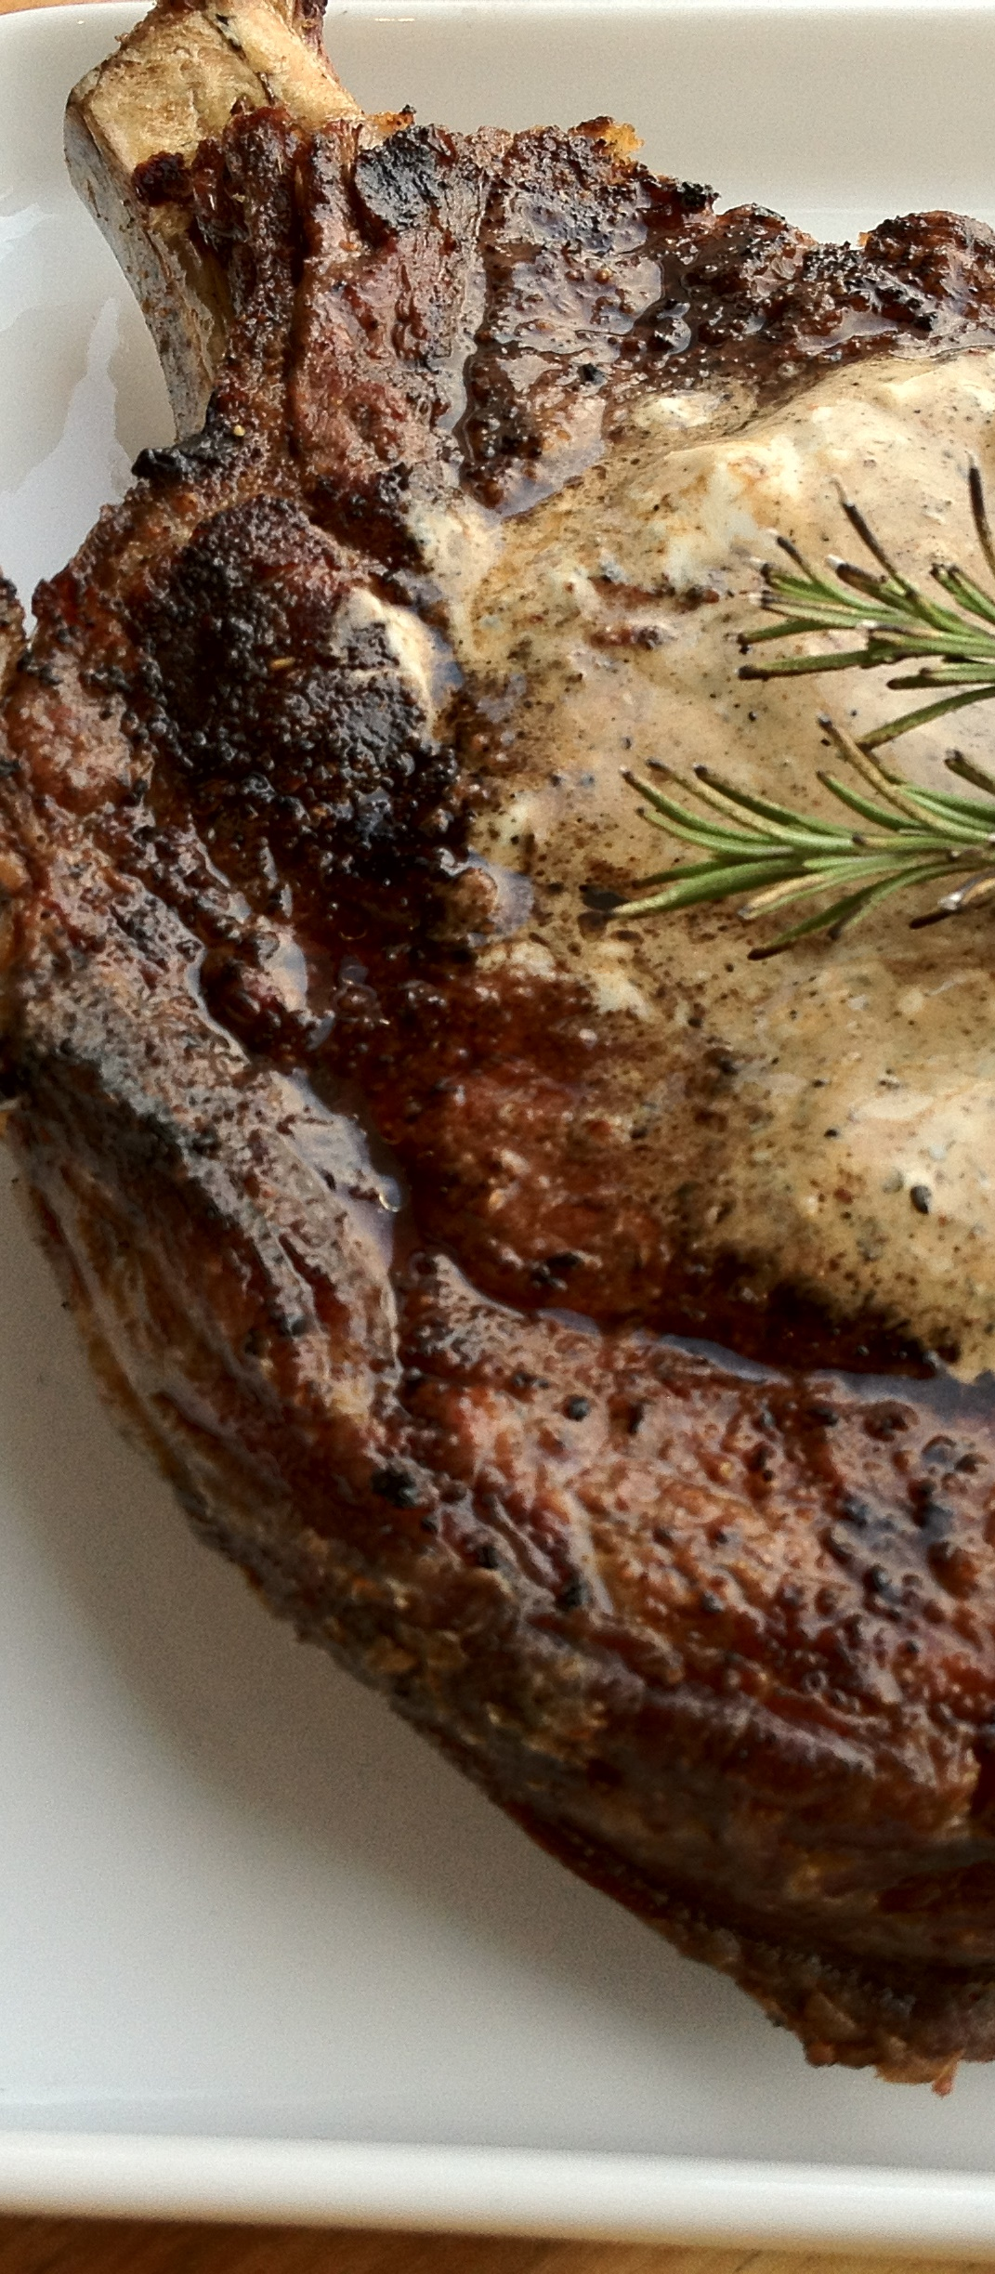
Notes:
First of all, you should season everything. People think that salt makes food taste salty. That’s because they’re doing it WRONG. Salt shouldn't be used at the table it should be used in the kitchen, before and during the cooking process. Used properly salt magnifies food’s natural flavors. It makes Beef taste beefier and chicken taste more chickenery.
1:45

Slide 8
Notes:
Next, most dishes are better with a little bit of acid added at the very end of cooking. Try squeezing some citrus or adding some vinegar to your pan to wake up the flavor of anything you eat.
2:00

Slide 9
Notes:
And finally, remember that “brown food tastes good”. When you brown food you’re driving boring flavorless water out of it and caramelizing the ingredients natural sugars. Don’t be afraid to let food sit in a pan and actually turn brown.
2:15

Slide 10
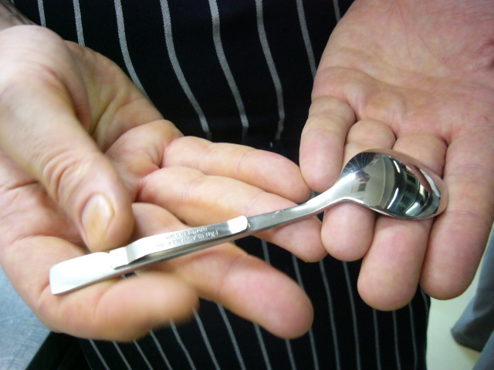
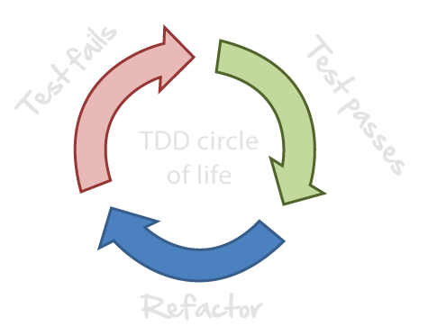
Notes:
But how much salt and acid should you add? When is an ingredient perfectly cooked? This is where Taste Driven Development comes in. Taste your food while it’s cooking. If it’s too bland, refactor your seasoning and test again.
2:30

Slide 11
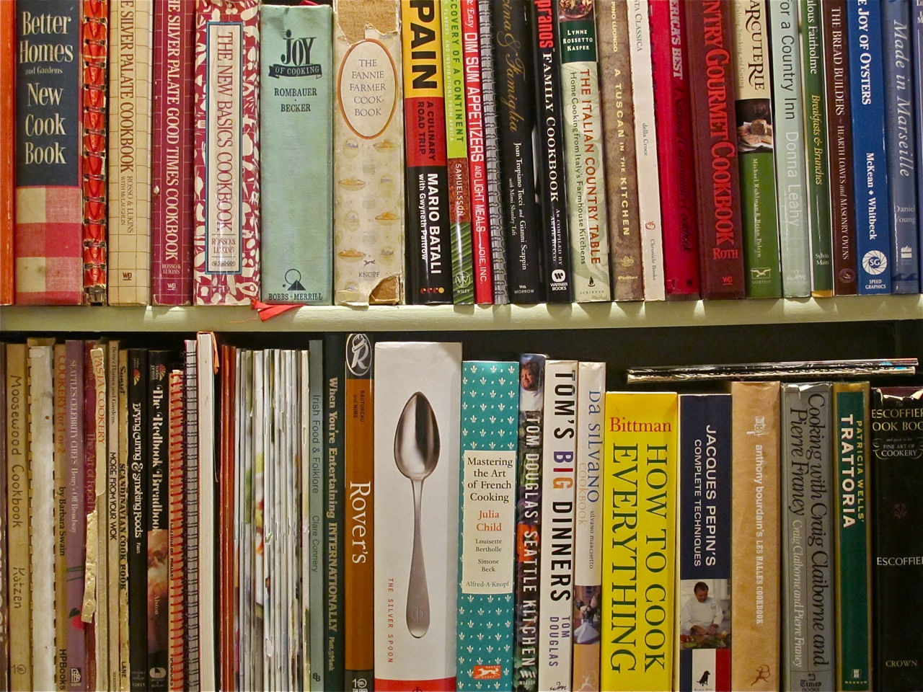

I am the Chief Technical Architect. You build it the way I tell you to bro.
Notes:
Next, throw out your cookbooks. Cookbooks authors are just astronaut architects dictating from on high how systems should be built, reducing you to nothing more than a code monkey.
You can architect a tasty dish yourself: You don’t need a cookbook. here’s how.
2:45

Slide 12
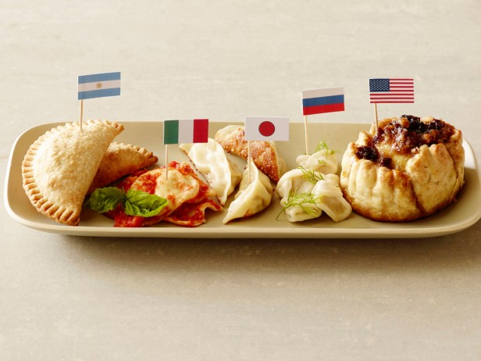
<<interface>> IDumpling
Empanada
Gyoza
+ wrapper
+ filling
Knish
Ravioli
Tamale
Samosa
Pelmeni
Pierogi
Notes:
First, break down a dish you like into it’s basic abstractions. For example all of these foods implement the IDumpling interface. Once you understand the interface of a dish, you can twist it and implement it however you want:
3:00

Slide 13
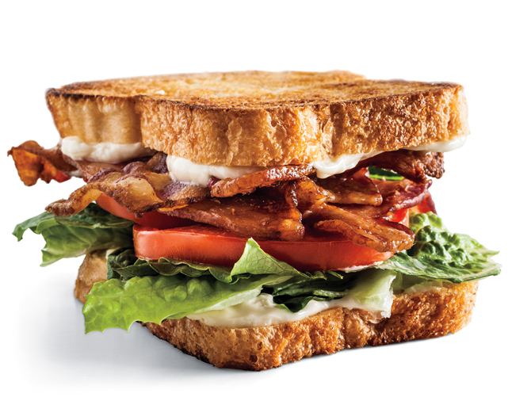
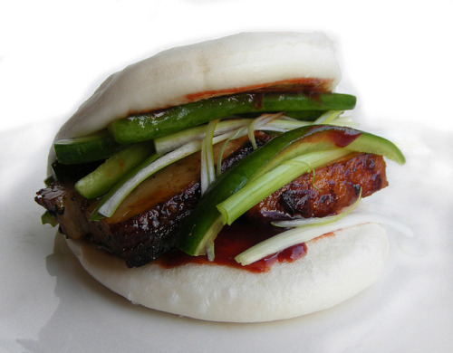
Starchy Container
Fatty Protein
Cooling Crunch
Flavorful Sauce
Notes:
This pattern of abstractions repeats itself across dishes all around the world with different ingredients, techniques and flavors. Sometimes the components are rearranged a lot: For example, these sandwiches share the same architecture as Spaghetti Carbonara and most tacos.
3:15

Slide 14
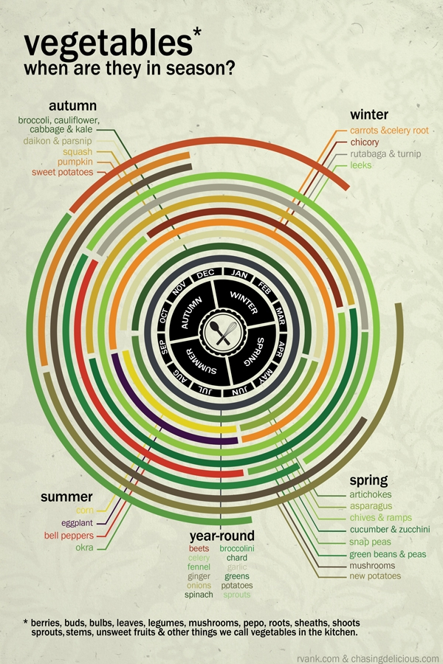
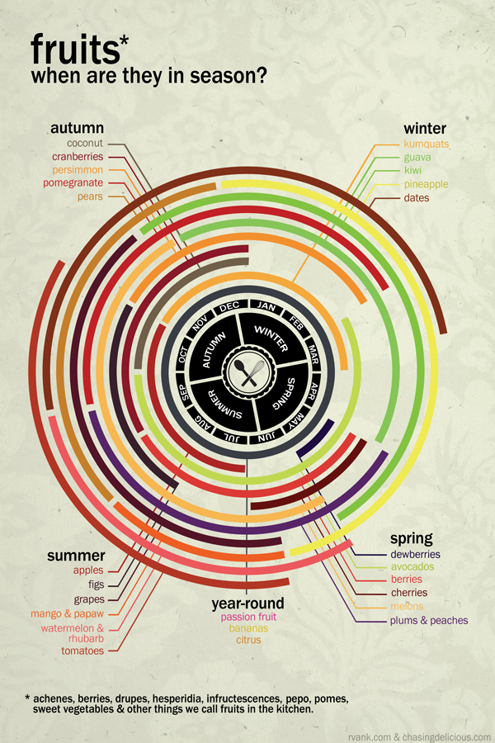
Notes:
From there, you just have to figure out which ingredients to pair together.
But that’s pretty simple, because, ingredients that grow together, go together.
If they grow together seasonally, or if they grow together regionally they almost always taste good with each other.
3:30

Slide 15
2
Notes:
And I know picking produce is hard… You’re running around the store squeezing things and shaking things and holding them up to the light trying to find the perfect piece of whatever.
And then we gotta peel off all those freaking little stickers al-Qaida puts on there.
But do try to use the best ingredients you can find.
3:45

Slide 16
3
Notes:
Using sub-par ingredients just doesn’t work.
Have you ever used milk the day after it expired? It’s terrifying. You’re running around “I smelled it, you smelled it what’s it supposed to smell like. I dunno! It smells like milk to me!”
It’s the same feeling I get when I use .NET Core: Is this thing any good? I tried it, you tried it it feels like Node to me!
4:00

Slide 17
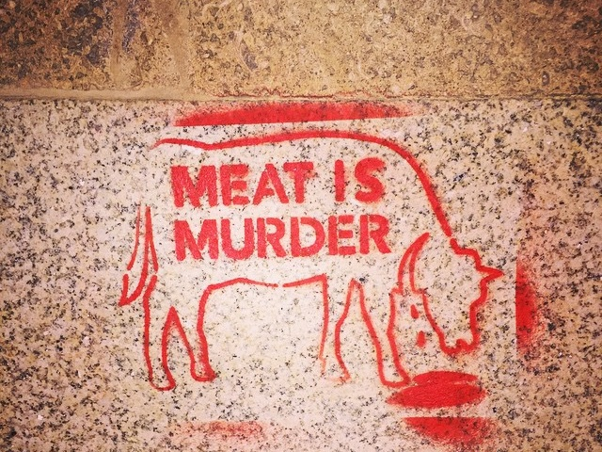
Notes:
And lastly, I’ll tell you – don’t worry about what other people think. Just make food that you like to eat for the people you like to be with.
Is anyone in here gluten free? Communists! Gluten free is such a 1st world problem. Ain’t no one living in the projects eating gluten free – I can tell you that.
4:15

Slide 18
2
Notes:
And vegans, don’t even get me started on vegans. I’m a level 8 vegan… I don’t eat anything with a shadow. I’m never going to invite you to dinner.
4:30

Slide 19

MUTABILITY
3
Notes:
Fsharp developers are just as bad as vegans. We get it, everything you do is better than us.
Man, if you’re an Fsharp vegan, you should just delete your twitter account right now. You’re officially the worst. No one wants to hear from you.
4:45

Slide 20
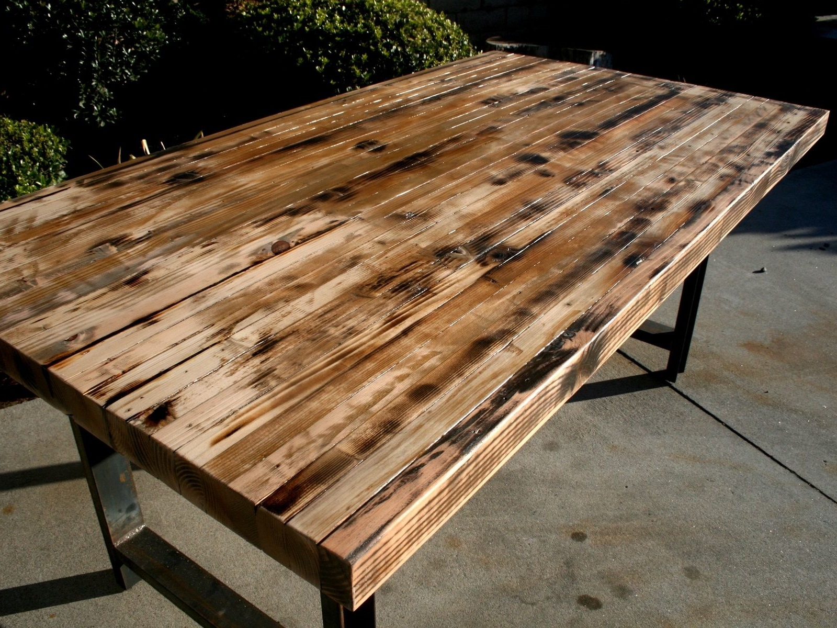
Notes:
Alright, in all seriousness. No matter what you end up cooking – always remember the reason you’re cooking that meal is to nurture and bring people together. That’s means that out of all the tools in your kitchen, your table is the most important because it’s where everyone comes together.
Thanks pubconf, you were great and I was awesome!
5:00

Slide 21

Bootlegged

